Slide 1
Political Geography: Concepts and Conundrums
Colorado Geographic Alliance Workshop
-----
Edward Holland, University of Colorado Boulder
11 February 2012

Slide 2
Presentation Outline
A working definition of political geography: Who gets what, when, where and how?
Actors in the international system: nations, states, nation-states and international organizations.
The competition for territory and resources.
The role of timing in international politics.
More than just a variable: using geography and location to identify spatial patterns in conflict.
The means for the success in the international system: the application of hard and soft power.

Slide 3
Who? Actors in the International System
A nation – a group of people who share a common language, religion, ethnicity, history and/or kinship.
The primordial origin of the nation: though nationalism as political project is new, the origins of the nation are ancient.
The modern origin of the nation: modernity—specifically the age of ‘print-capitalism’—facilitated the rise of the nation as the basis for common identity.
A state – a territorially-defined political unit controlled by a bureaucratic system and holding a monopoly on force.
A nation-state – an idealized political construct, which seeks to make the national group coterminous with the borders of the state.
No pure nation-states exist in the international system.

Slide 4
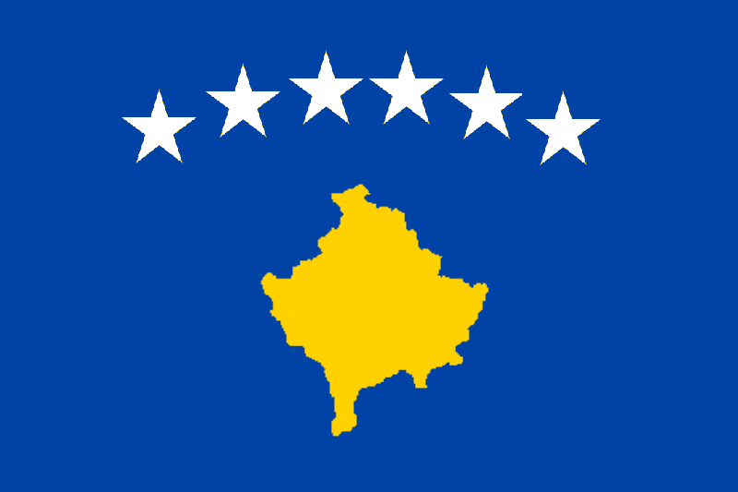
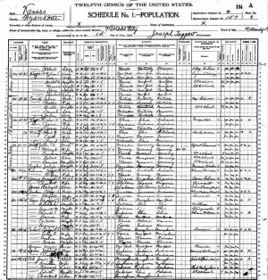
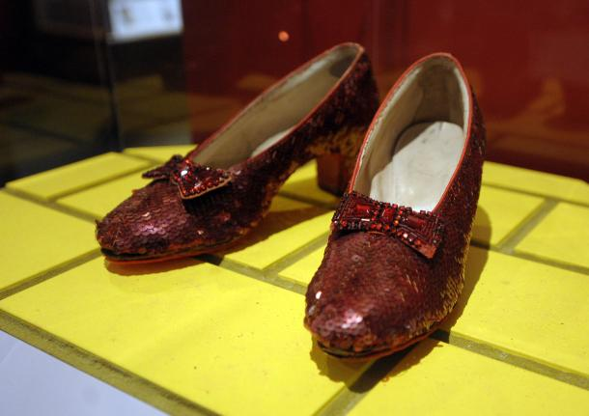
Technologies of the Nation
The flag of Kosovo
The 1900 U.S. Census
Dorothy’s shoes at the Smithsonian

Slide 5
The emergence of non-state actors
Non-governmental organizations: increased involvement of such groups in conflict and post-conflict zones.
The ‘international community’: the United Nations and the International Criminal Court as examples.

Slide 6
What? The competition for territory and resources
Territory: more than a ‘bounded space’ or a ‘bordered power container.’
The control of territory is necessary for the state to implements its political and cultural projects.
Territory is historically contingent: consider territorial control in Eastern Europe during the 20th century.
Resources: objectives of control in most military action
Resources are various: oil, land, gold, people
The history of the ‘colony’: an occupational technique designed for the control of resources.
Notes:
Territorial control of the present-day city of Lvov: Austro-Hungarian Empire, interwar Poland, Soviet occupation, German occupation, Soviet re-occupation, the Soviet Union, independent Ukraine.

Slide 7
When? Timing in international politics
Events concentrate in time (and place), depending on the situation in the broader international community.
Reversals are often spatially and temporally dependent, as well.
The waiting game…‘You have the watches. We have the time.’

Slide 8
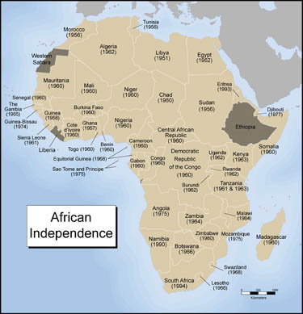
Independence for colonies in Africa

Slide 9
Where? The geography of contemporary conflict
Conflict is a geographically uneven process: during wars, some parts of states experience significantly higher levels of violence than other areas.
Part of the broader trend in political geography to turn away from ‘methodological nationalism.’

Slide 10
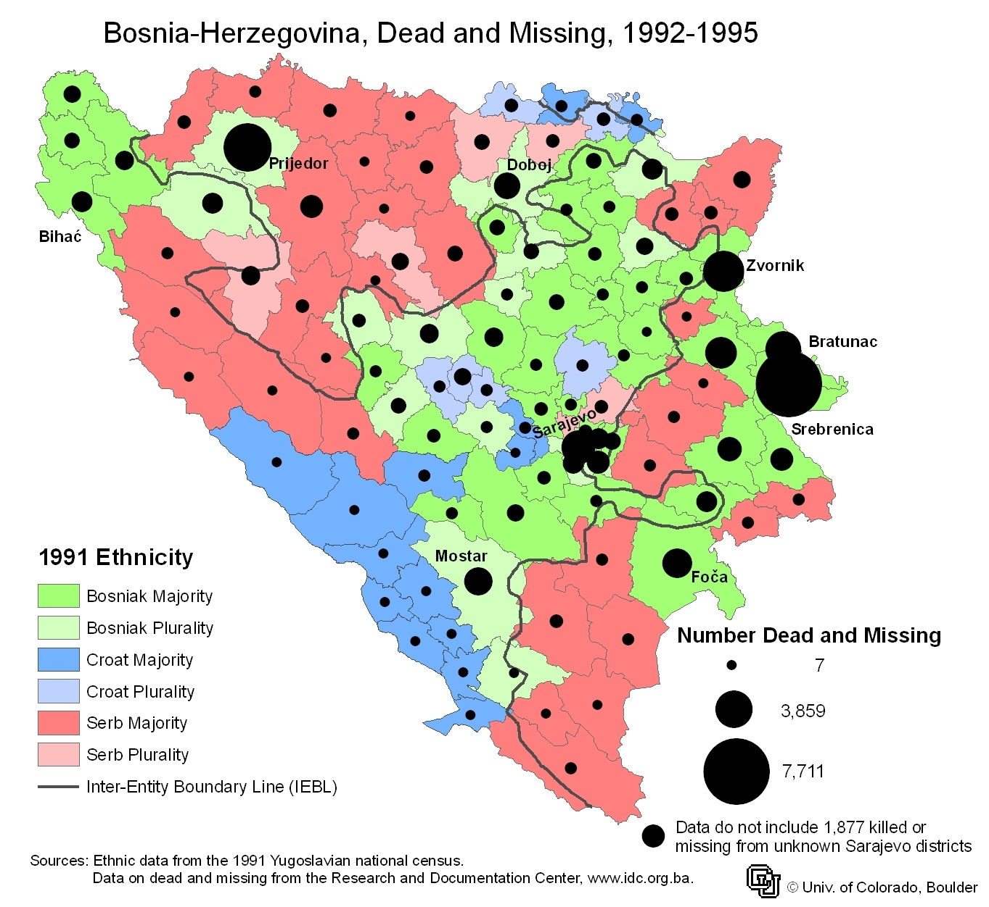
More than just a variable…

Slide 11
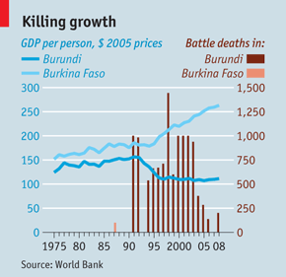
The effects of conflict

Slide 12
How? The means for the success
in the international system
Hard power – the use of direct military or economic intervention to meet foreign policy aims.
Soft power – the use of diplomacy and culture to influence the actions of other states in international politics.
Make other ‘want what you want [and have]’
-- Joseph Nye (2004)

Slide 13
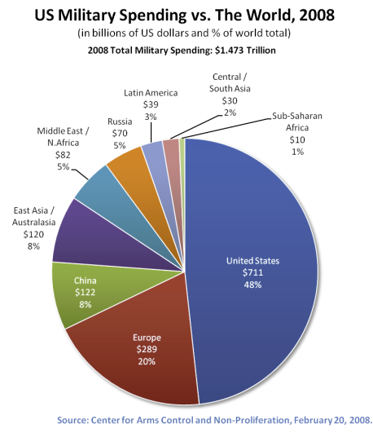
An index of hard power

Slide 14
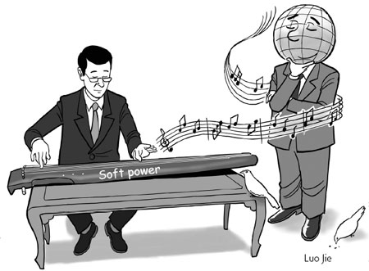
The (re)turn to soft power

