Slide 1
The History and Geography of Afghanistan
Colorado Geographic Alliance Workshop
-----
Edward Holland, University of Colorado Boulder
11 February 2012

Slide 2
Presentation Outline: Part I
Who? The Key Actors Historically and Today in Afghanistan
Great Britain and the Russian Empire during the Great Game
The Soviet Union in Afghanistan, 1979-1989
The power vacuum of the 1990s and the rise of the Taliban
‘The Forever War’—the U.S. military in Afghanistan since 2001
What? Why Afghanistan is a continual site of conflict
The competition for control of Central Asia during the 19th century—Afghanistan as the archetypal buffer state.
Charlie Wilson’s war and the concept of blowback
Islamic law and gendered violence under the Taliban
The problem of state failure: Why is the U.S. still in Afghanistan?
When?
A summarizing timeline and the role of timing in political geography

Slide 3
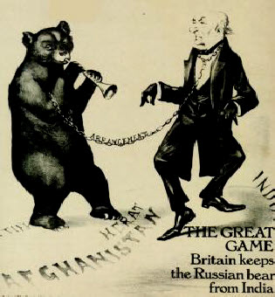
The Great Game
Rivalry between the British and Russian Empires for control of Central Asia.
Afghanistan as a buffer state between the two empires.

Slide 4
The Soviet Union in Afghanistan, 1979-1989
Under the leadership of Leonid Brezhnev, the Soviets sent forces to Afghanistan to prop up the Communist regime that had taken power there in 1978.
Fighting against the communists were the mujahedeen (trans. those who struggle for god), a loosely organized faction supported by the Pakistani security services (the ISI) and the United States.

Slide 5
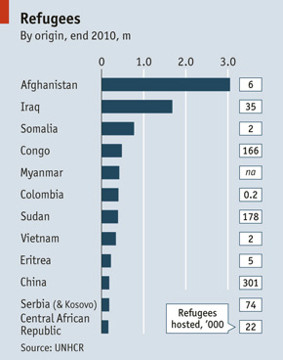
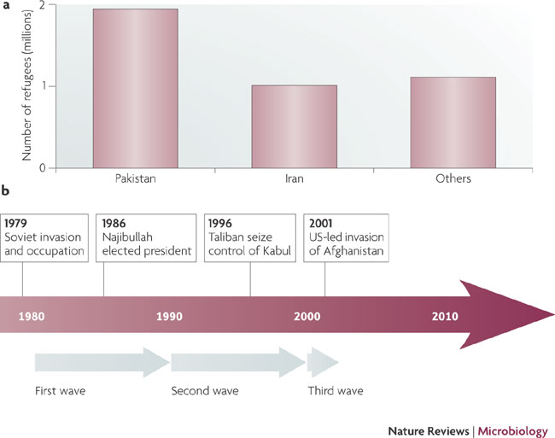
Consequences of conflict: Refugees

Slide 6
Afghanistan in the 1990s
The civil war continues after Soviet withdrawal, though the communists remain in power until 1992.
The Taliban (trans. students in Pashto) establish a foothold in Kandahar in 1994.
Practice an austere form of Islam known as Wahhabism.
Made up of mujahedeen and ethnic Pashtuns who were trained in religious schools (primarily in Pakistan).
The Taliban take control of Kabul in 1996.

Slide 7
Notes:
By 2001, the Taliban controlled 90 percent of the territory of Afghanistan.
Assassination of Massoud, leader of the Northern Alliance, two days before the 9/11 attacks.

Slide 8
The U.S. in Afghanistan: Initial Successes
October 1999: The Taliban provide sanctuary to Osama Bin Laden and Al-Qaeda.
October 2001: In response to September 11th, the U.S. and its allies—including the U.K., Canada, Australia, France and Germany—launch Operation Enduring Freedom.
November 2001: Military successes against the Taliban came fast and quick; the U.N. offers humanitarian support.
December 2001: The interim government under the leadership of Hamid Karzai is established. Karzai is democratically elected president in October 2004.

Slide 9
The U.S. in Afghanistan: Descent into Chaos
Summer 2006: four-fold increase in the number of suicide bombings and a doubling in improvised explosive device detonations.
August 2008: the problem of collateral killings takes center stages, as U.S. forces are accused of killing 140 civilians in Farah Province.
February 2009: a new American strategy—based on increased aid to Pakistan and measurable progress—is introduced. In December 2009, President Obama announces a substantial increase in troop levels.
2014: scheduled date for the complete withdrawal of American forces.
Notes:
Farah province is in western Afghanistan.

Slide 10
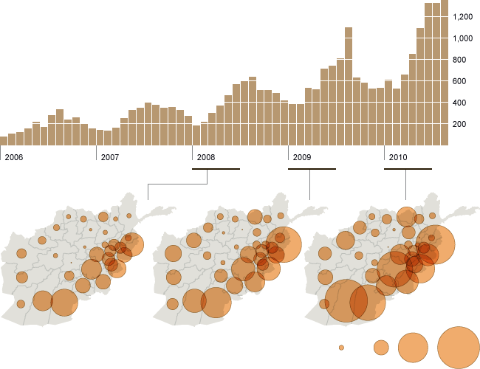
The Deterioration of the Security Situation
Insurgent attacks by month
Insurgent attacks by province, Jan.-Jun.
10
100
400
800
Source: http://www.nytimes.com/interactive/2010/09/12/world/asia/20100912-afghan-indicators.html

Slide 11
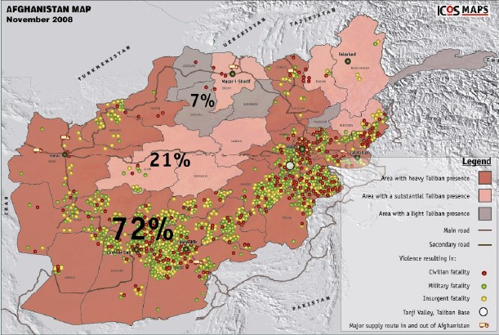
The Taliban’s Recent Expansion

Slide 12
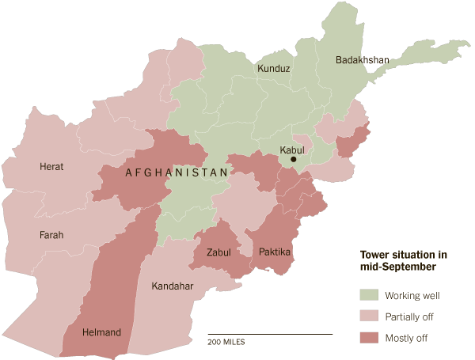
The Geography of Cell Phone Use
Source: http://www.nytimes.com/interactive/2011/10/05/world/middleeast/turned-off-cellphone-towers-in-afghanistan.html?scp=16&sq=afghanistan&st=cse
Notes:
- The Taliban force cell phone towers to be shut down at night

Slide 13
Presentation Outline: Part I
Who? The Key Actors Historically and Today in Afghanistan
Great Britain and the Russian Empire during the Great Game
The Soviet Union in Afghanistan, 1979-1989
The power vacuum of the 1990s and the rise of the Taliban
‘The Forever War’—the U.S. military in Afghanistan since 2001
What? Why Afghanistan is a continual site of conflict
The competition for control of Central Asia during the 19th century—Afghanistan as the archetypal buffer state.
Charlie Wilson’s war and the concept of blowback
Islamic law and gendered violence under the Taliban
The problem of state failure: Why is the U.S. still in Afghanistan?
When?
A summarizing timeline and the role of timing in political geography

Slide 14
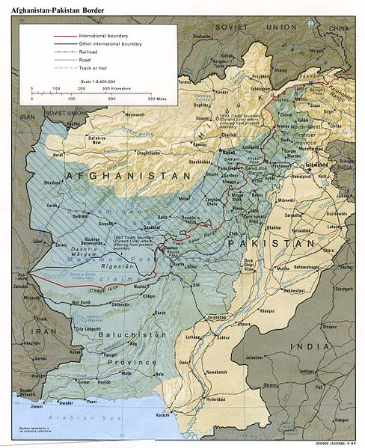
Afghanistan as Archetypal Buffer State
The Durand Line
Drawn as part of an 1893 agreement between Britain and Afghanistan.
Originally viewed as a ‘line of control;’ becomes an inter-national boundary after 1947.
Divides the Pashtuns between two states.

Slide 15
America’s support for the Mujahedeen
Financial and arms support
Roughly $10 billion provided for training and arms purchases
Provision of Stinger surface-to-air missiles
Training provided to the Pakistan security services, the ISI
After the Soviet withdrawal, arms shipments to the country continued through 1992.
Blowback: ‘the unintended consequences of a covert operation that are suffered by the civil population of the aggressor government.’ (Chalmers Johnson)
Notes:
One man’s freedom fighter is another‘s terrorist.

Slide 16
Islamic Law and Gender Violence under the Taliban
Education
Girls older than eight were barred from school.
All women were banned from employment, leading to the firing of nearly 8,000 school teachers in Kabul.
Public space
Forced to wear a burqa (full-length covering) at all times outside the home.
Mobility
Women were not allowed to travel by bicycle or motorcycle.
Barred from using taxis without an escort.
Gender segregation on public buses.

Slide 17
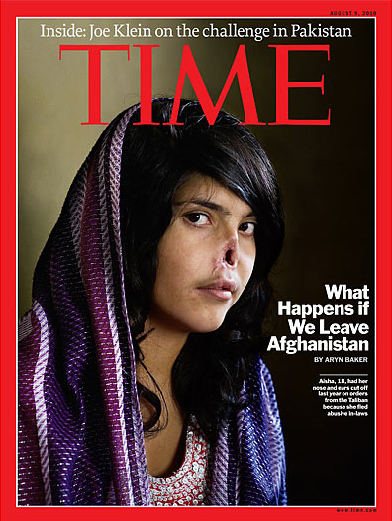
Continued concerns
The potential consequences of negotiations with the Taliban.
Notes:
2009 attack for leaving her abusive husband. Her ears were also cut off.

Slide 18
A Taxonomy of Failed States
Anarchic states: lacking any centralized government whatsoever. Example: Somalia
Phantom states: state control extends to limited areas or persons. Example: present-day Afghanistan
Anemic states: states unable to establish effective governing institutions, due to corruption or violence. Example: Haiti

Slide 19
State Failure Index, 2011

Slide 20
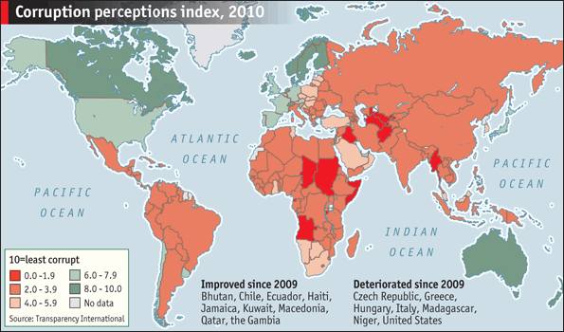
Corruption Perception Index, 2010

Slide 21
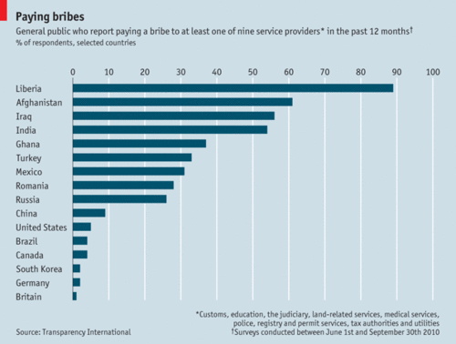
Bribes and state failure

Slide 22
Presentation Outline: Part I
Who? The Key Actors Historically and Today in Afghanistan
Great Britain and the Russian Empire during the Great Game
The Soviet Union in Afghanistan, 1979-1989
The power vacuum of the 1990s and the rise of the Taliban
‘The Forever War’—the U.S. military in Afghanistan since 2001
What? Why Afghanistan is a continual site of conflict
The competition for control of Central Asia during the 19th century—Afghanistan as the archetypal buffer state.
Charlie Wilson’s war and the concept of blowback
Islamic law and gendered violence under the Taliban
The problem of state failure: Why is the U.S. still in Afghanistan?
When?
A summarizing timeline and the role of timing in political geography

Slide 23
A Timeline of Key Events and Timing in Political Geography
December 1979: Soviet forces enter Afghanistan
Post-Vietnam attempts by the U.S. to humiliate the Soviets militarily; the Islamic Revolution in Iran; Ronald Reagan’s election and the ‘Second Cold War’
The post-Soviet power vacuum and the rise of the Taliban
The triumph of democracy in the Cold War; America’s uncertainty regarding its hegemonic status
September 11th
The rise of neoconservatism with the election of President Bush; the harboring of Bin Laden in Afghanistan; the war in Iraq distracts the U.S. from its original mission

Slide 24
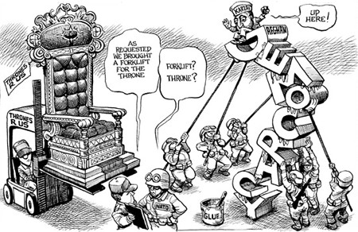

Slide 25
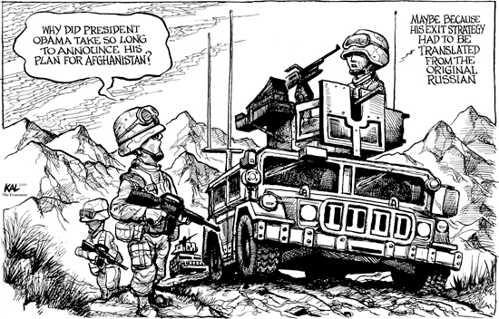

Slide 26
The Onion: America’s Finest News Source

Slide 27
Source: http://www.theonion.com/articles/
us-continues-quagmirebuilding-effort-in-afghanista,2837/

Slide 28
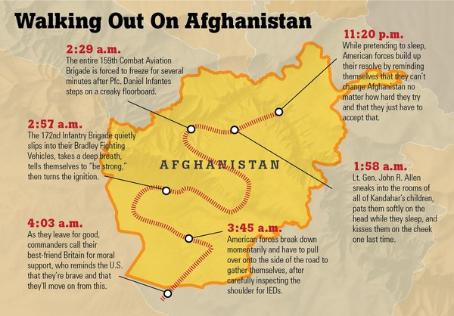
U.S. quietly slips out of Afghanistan in dead of night

Slide 29
Presentation Outline: Part II
Where? The Political Geography of Violence in Afghanistan
Identifying the key sites: Kabul, the Khyber Pass, the Durand Line, Kandahar
Mapping the conflict in Afghanistan: The Geography of Violence and the WikiLeaks data
How? The Modern Way of War in Contemporary Afghanistan
Fundamentalism and the rise of the Taliban—the main causes
Drone attacks and their geography
How does it end?
Suggested Readings
Q&A

Slide 30
Source: O’Loughlin et al 2010; http://www.colorado.edu/ibs/pec/johno/afpak/docs/OLoughlin_AfPak.pdf

Slide 31
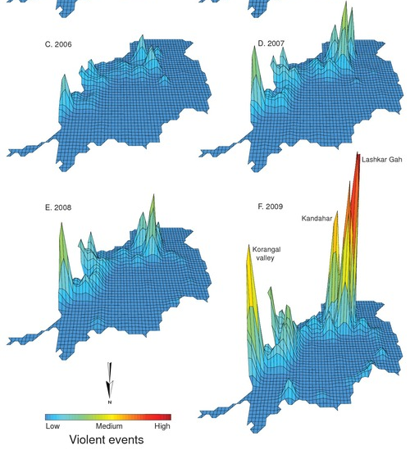
Violence in Afghanistan,
viewed from the north

Slide 32
Presentation Outline: Part II
Where? The Political Geography of Violence in Afghanistan
Identifying the key sites: Kabul, the Khyber Pass, the Durand Line, Kandahar
Mapping the conflict in Afghanistan: The Geography of Violence and the WikiLeaks data
How? The Modern Way of War in Contemporary Afghanistan
Fundamentalism and the return of the Taliban—the main causes
Drone attacks and their geography
How does it end?
Suggested Readings
Q&A

Slide 33
The Rise, Fall, and Rise of the Taliban
After the initiation of conflict in October 2001, many of the Taliban flee across the border to Pakistan.
By 2006, the Taliban had reestablished its presence in its historic stronghold in southern Afghanistan.
Concerns remain among the various members of the international community:
Russia fears the rise of Islamism in Central Asia
China has similar concerns with respect to Muslim population in its west.
The United States worries that the Taliban will again open its doors to terrorist organizations.

Slide 34
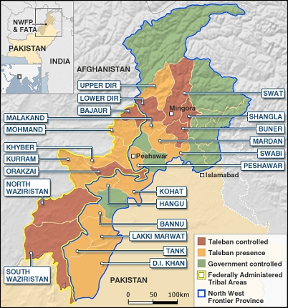
Pakistan as safe haven

Slide 35
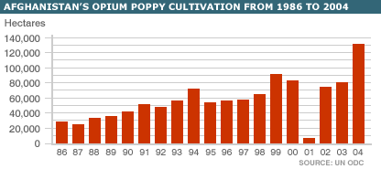
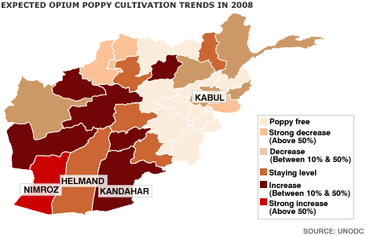
Concerns regarding opium production
Opium production in Afghanistan has
steadily increased over the past 25
years, with a sharp rise noted recently.
Currently, opium cultivation is used as
a funding mechanism by the Taliban.

Slide 36
The Geography of Drone Attacks
“Humankind had a 5,000-year monopoly on the fighting of war. That monopoly has ended”
-- Peter W. Singer
Source: Shaw and Akhter, forthcoming

Slide 37
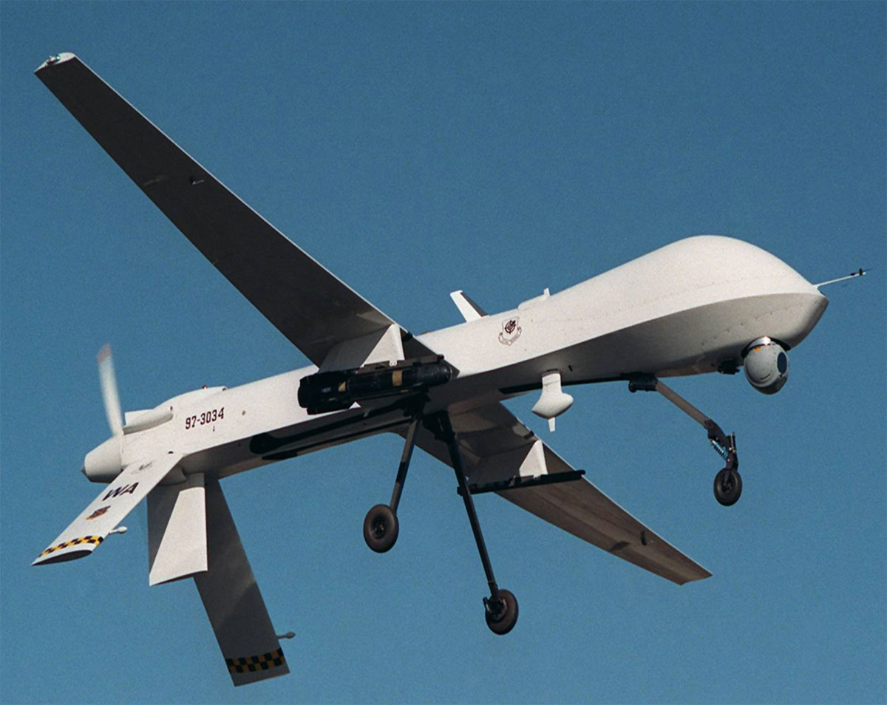

Slide 38
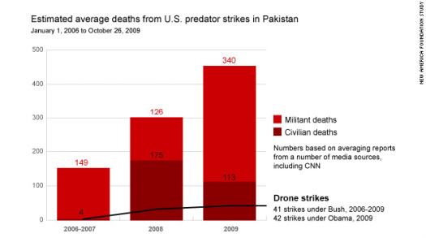
Incidence of Drone Attacks, 2006-2009
Source: http://afpak.foreignpolicy.com/posts/2009/10/29/pakistan_drone_war_takes_a_toll_on_militants_and_civilians

Slide 39
How does it end?
Three possible outcomes:
Best scenario for the United States – Karzai coalition is successful and the inter-ethnic alliance holds. A successor to Karzai is elected in 2014.
2nd-best scenario for the United States – formal government remains in place in Kabul with informal regional/ethnic authorities.
Likely scenario – 3 or 4 de facto states (the government in Kabul, Pashtun areas controlled by the Taliban, along with Tajik, Uzbek, and Iran-supported territories in the north and west)

Slide 40
Suggested Readings
The Great Game
The Great Game, by Peter Hopkirk
Tournament of Shadows, by Karl Meyer and Shareen Brysac
Kim, by Rudyard Kipling
The Soviet Union in Afghanistan
The Great Gamble, by Gregory Feifer
The pre-2001 period
Ghost Wars, by Steve Coll
The Forever War, by Dexter Filkins
Since 2001
Descent into Chaos, by Ahmed Rashid

